Slide 1
Data Interface for EV Charge Base
A NoSQL based Online DB Interface
Haixiang Xu, hxu@caltech.edu
Course Project, EE135 Power Systems Analysis, 2015-16 winter

Slide 2
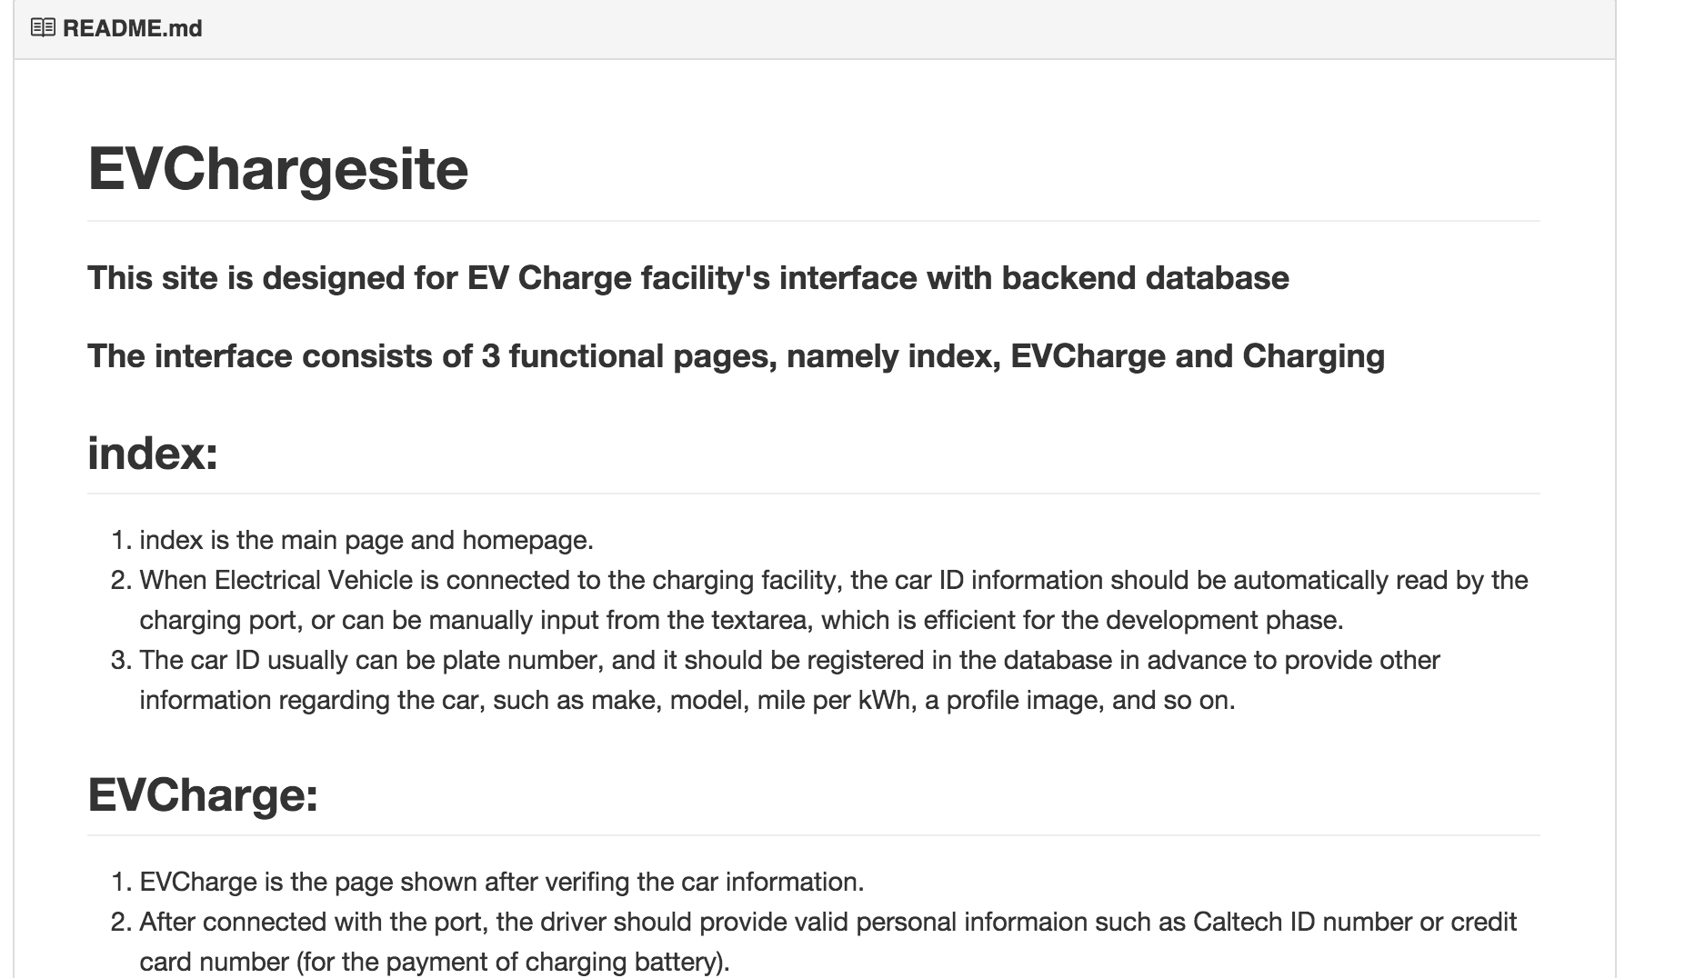
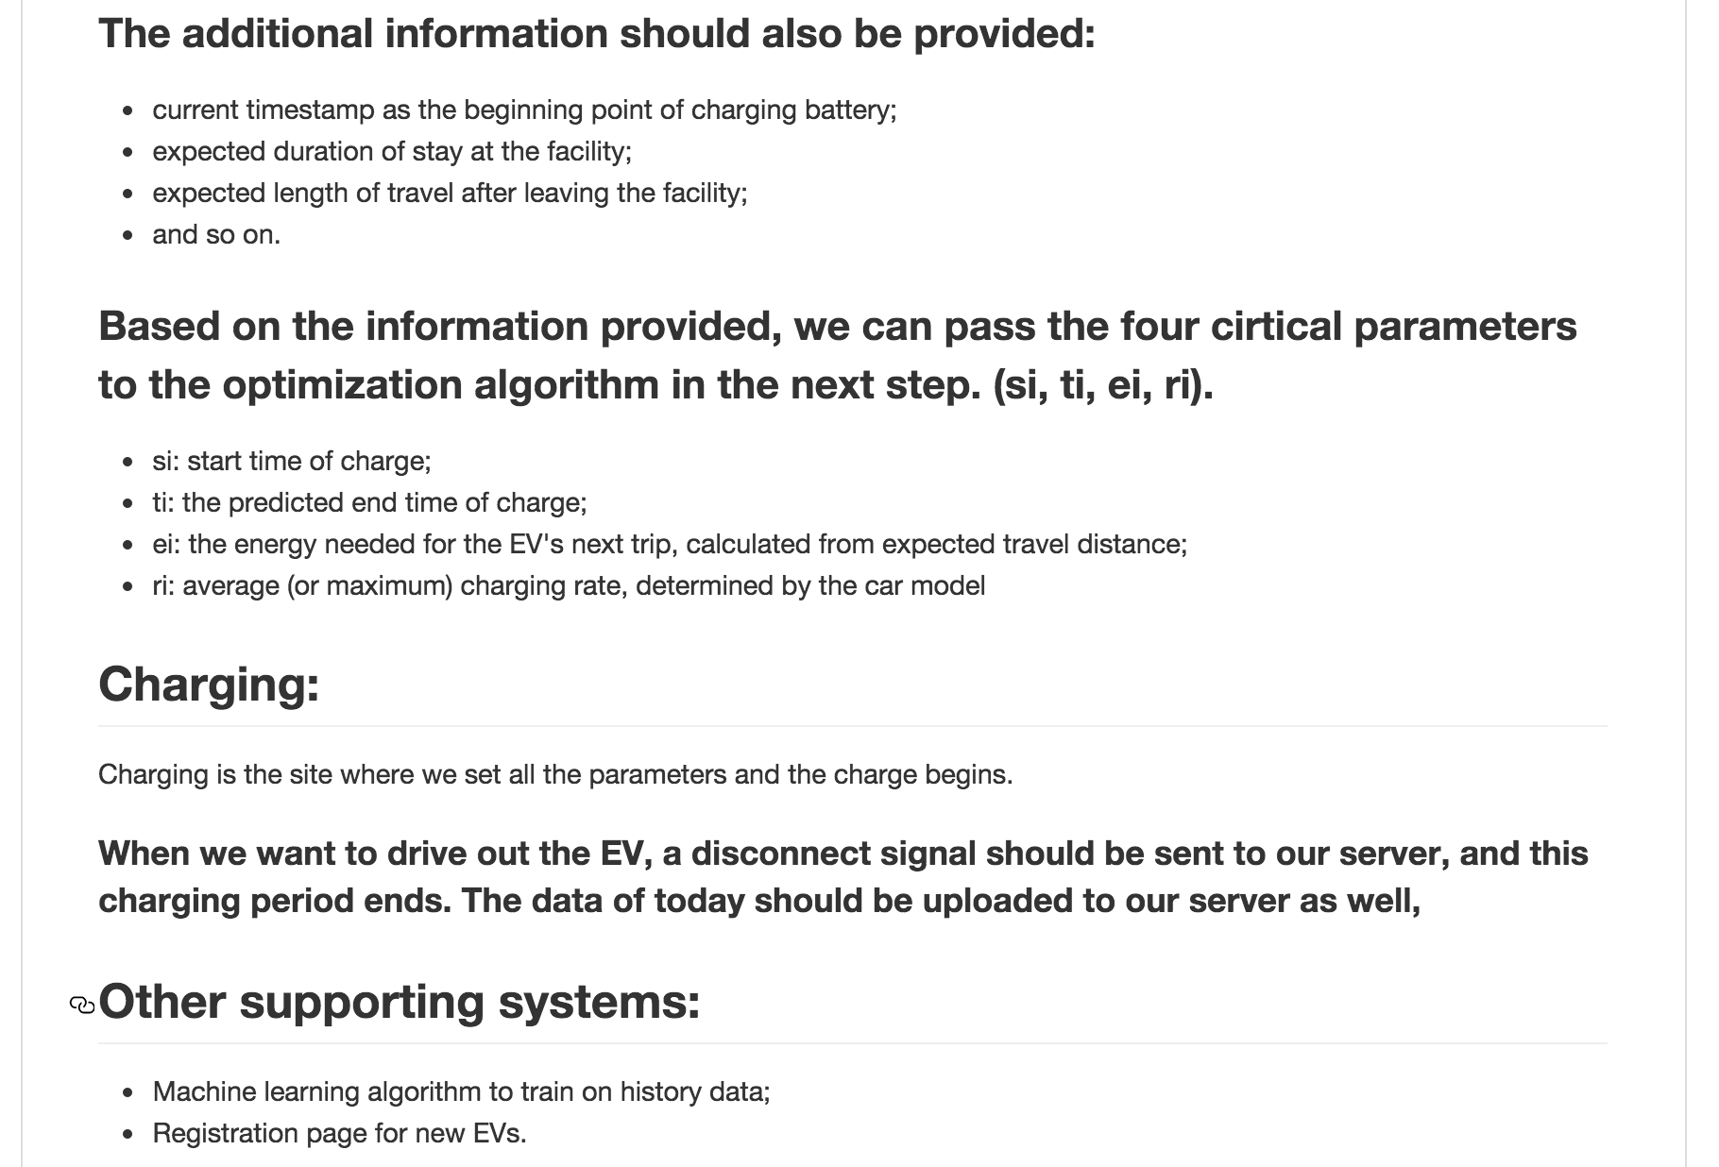
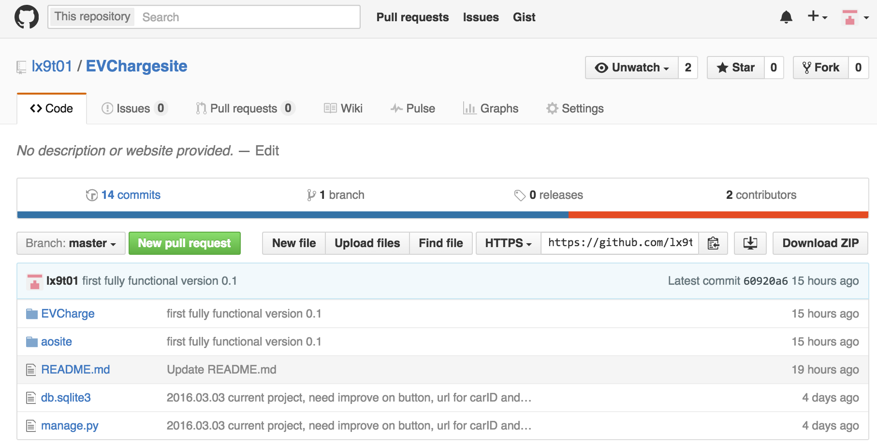
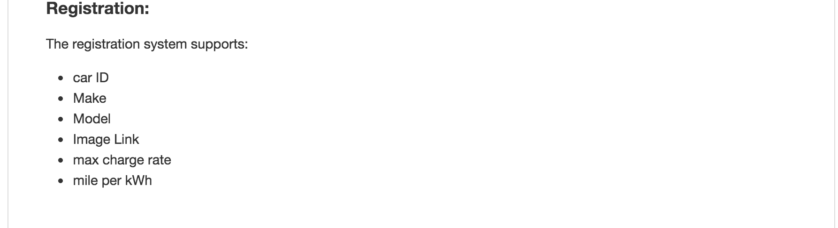
Content
Overview and Components
Solution
User Specific Pattern
Demo
Further Improvements
https://github.com/lx9t01/EVChargesite

Slide 3

Overview
Complete functional interface with basic web UI
Machine Learning algorithm dealing with user pattern
EV Information
Interface Front-end
Django
HTML
Interface Back-end
MongoDB
mLab
Data Analysis
Non-linear regression
based on decision tree

Slide 4
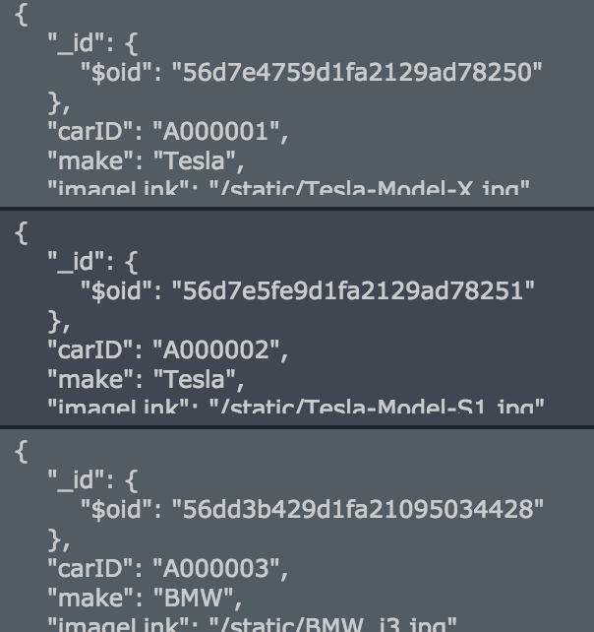
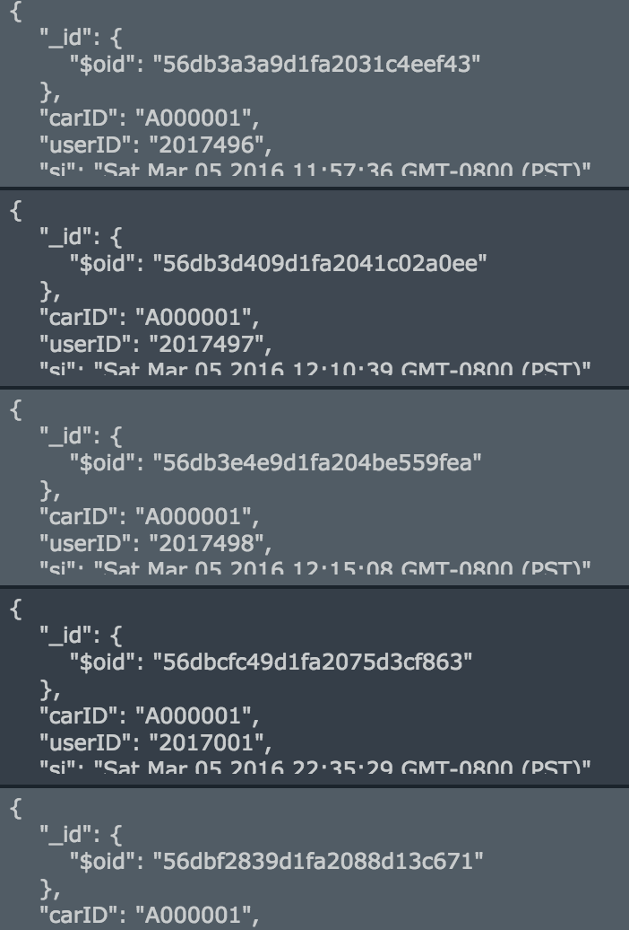

Solution
{ “_id”: { “$oid”: “56d7e4759d1fa2129ad78250” },
“carID”: “A000001”,
“make”: “Tesla”,
“imageLink”: “/static/Tesla-Model-X.jpg”,
“maxRate”: 1.5,
“model”: “Model X”,
“milePerKWh”: 3
}
Front-end: Django web framework
Back-end:
MongoDB
mLab (MongoLab)
{ “_id”: { “$oid”: “56db3a3a9d1fa2031c4eef43” },
“carID”: “A000001”,
“userID”: “2017496”,
“si”: “Sat Mar 05 2016 11:57:36 GMT-0800 (PST)”,
“ti”: “Sat Mar 05 2016 19:57:46 ”,
“ei”: “10”,
“duration_exp”: “1”,
“ri”: “1.5”
}
EV Information
Interface Frontend
Interface Backend
Data Analysis

Slide 5
Solution
When connected to an unregistered EV, promote registration
When connected to a registered EV:
input EV ID information
input driver information
input expected duration of stay
input expected distance of travel
Calculate total energy to be charged based on car model and distance
Predict user’s pattern of leaving according to historical data
Train every time new data arrives
Predict every time the targeted car arrives

Slide 6
Prediction for User Pattern
8：00
9：00
10：00
11：00
12：00
13：00
14：00
15：00
16：00
17：00

Slide 7
Demo
http://localhost:8000/EVCharge

Slide 8
Further Improvements
More comprehensive data structures
Efficient uploading/downloading
Train and update decision tree model offline, and store model on cloud
Train algorithm on more general properties
Cooperate with optimization algorithm and tune with electricity demand
More robust deployment, false-tolerant data filtering

Slide 9
Resources
Git repository:
https://github.com/lx9t01/EVChargesite
Django Project:
https://www.djangoproject.com/
MongoDB:
https://docs.mongodb.org/manual/?_ga=1.157630266.1838534861.1456294363
mLab:
http://docs.mlab.com/
Stackoverflow-oriented-programming

Slide 10
Thank you

